Slide 1
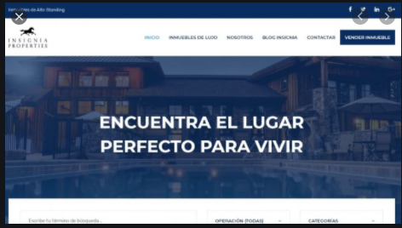




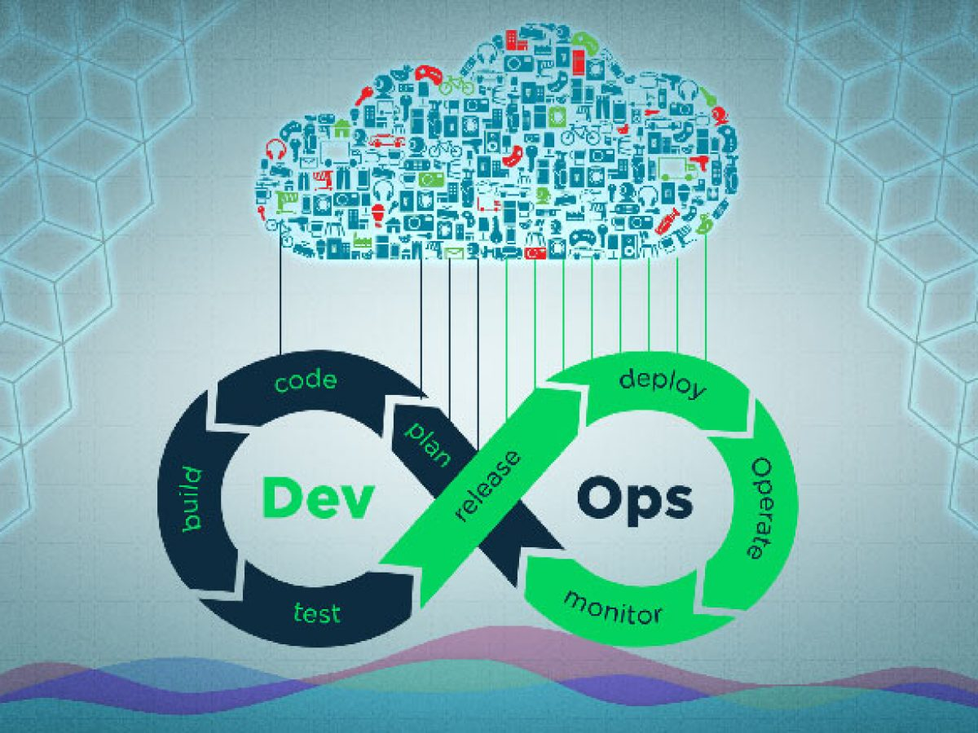

Home
Contact
Directory
Stream Video
IT Mexico
Guidelines 2020
1. Ebitda and Sales - maximize organic growth rate
2. Cash Flow Ebitda, Capex optimization, Working Capital
3. Defend our current sources of profitability
4. Develop enablers to accelerate the organization's potential (culture, agility, innovation, basics and transformation)
5. Strengthen competitive advantages and generate opportunities to face challenges of each OU
6. Execute high potential opportunities
7. Develop and execute the strategy to win snacking and plant-based proteins at global scale
8. Develop and execute the strategy for new business models leveraging our competitive and structural advantages
9. Leverage global capabilities as One Single Company (GSO, footprint, cross-fertilization, align processes)
10. Explore the future
Gestión Impecable
Scrum Metodology
Devops
Consultas

Slide 2
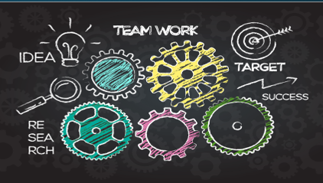
Home
Contact
Directory
Stream Video
Gestión Impecable
IT Mexico
Home
Scrum Metodology
Devops
Consultas

